Slide 1

Monitoring and Evaluating LLMs in Clinical Contexts with Azure AI Foundry FY25 Session 2 Upcoming sessions here

Slide 2



Speakers
Pablo Salvador Lopez
Principal AI Global Black Belt
Microsoft
*Lecturer at Northwestern University and Escuela Colombiana de Ingeniería Julio Garavito
Marcin Jimenez
Senior Cloud Architect - AI
Microsoft
Linkdln: Pablo, Marcin

Slide 3



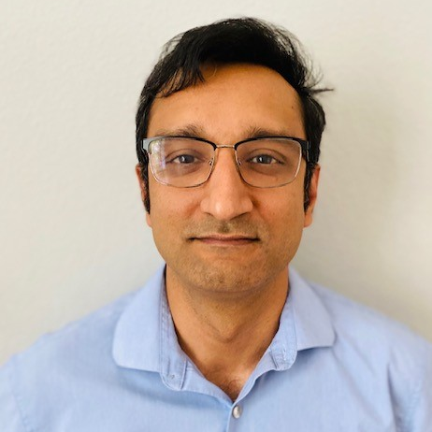
Q&A Moderators
Dhanshri More
Principal AI Global Black Belt
Microsoft
Shyam Patel
Principal AI Global Black Belt
Microsoft
Amit Mukherjee
Principal AI Technical Specialist
Microsoft
Piyush Pande
Principal AI Technical Specialist
Microsoft

Slide 4
Agenda
Topic | Time
Recap Session 1: Knowledge stores | 5 minutes
LLM Evaluation: The Missing Piece in Healthcare AI | 5 minutes
Establishing LLMOps Frameworks for Healthcare AI | 15 minutes
Hands-On: Evaluation Reasoning Clinical Pathways | 25 minutes
Wrap-Up & Q&A | 5 minutes

Slide 5


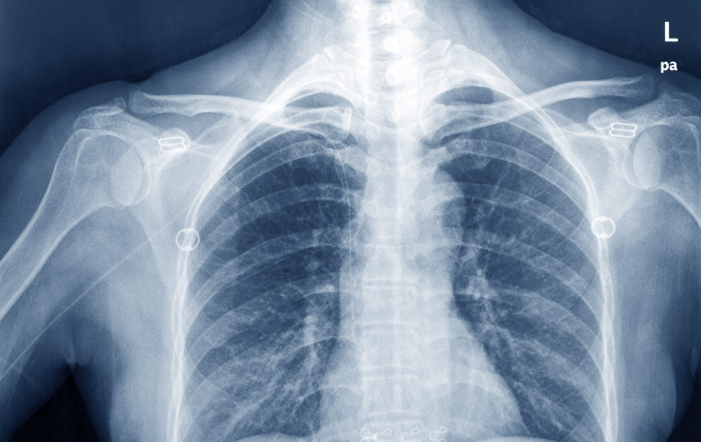
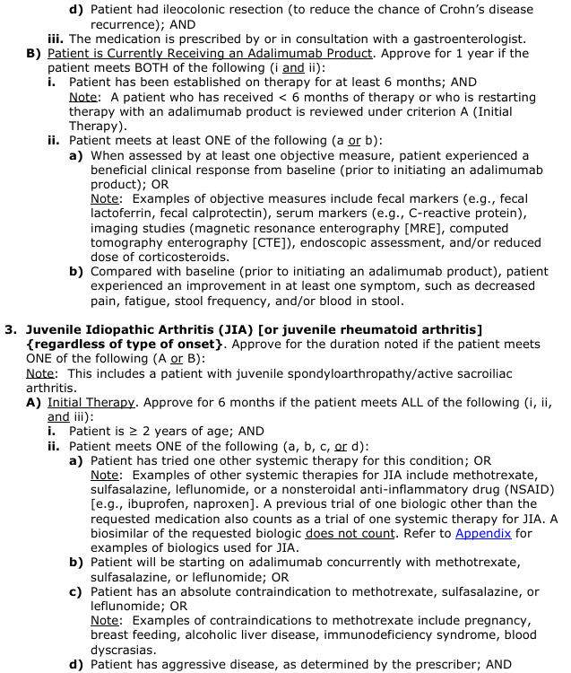

Recap Session 1 AI-Powered Clinical Knowledge Stores with Azure AI Search
Highlights
4 Labs for Accelerating the E2E AI Search Learning Curve
Where Can I Find the Assets?
Knowledge Store Creation: Use Cases Based on Policies and X-Rays
Session 1 Deck: Value Proposition, Deep Dive, and How-To
Visit HLSIgnited Repo or/and Webinar page

Slide 6





Imagine deploying AI that assists diagnoses patients without checking its answers
The Need for LLMOps
AI Apps
Azure OpenAI
Azure AI Agent Service
MD
Medical Decision Support App
Patient
No LLMOps, No Trust
There must be an evaluation process that assesses LLMs for their natural language processing performance and their translational value.
Source: A Survey on Evaluation of Large Language Models
Notes:
n medicine, every output matters — hallucinations can cause real harm. You can’t manage what you don’t measure — and right now, we’re barely measuring what these models do in production

Slide 7



Building A LLMOps Framework
Foundational Components
LLM/SLM
Data
Evaluation Metric
What
Where
Why
Narrow Down Task
Decide LLM/SLM Candidates
Find Datasets
Select Metric
Leaderboard
Similarity
Clinical Decision Support
Coherence
Gpt4o-mini
phi4
HeadQA
Dataset
Azure AI Foundry
How ? (Process)
Source: A Survey on Evaluation of Large Language Models

Slide 8




Building A LLMOps Framework
Medical Domains Pool
Clinical Note Generation
Medical Research Assistance
Benchmark Datasets Pool
Patient Communication Support
Clinical Decision Support
MedCalc-Bench
Medbullets
LLM/SLM Candidates Pool
HeadQA
Custom
LLM/SLM Benchmark Arena
HeadQA
Dataset
Similarity Scores Leaderboard
Gpt4o
Gpt4o-mini
phi4
Gpt4o-mini
Metrics Pool
Similarity
Fluency
phi4
Coherence
Custom
Which model has the highest similarity score (0–5)?
Azure AI Foundry
Data Scientist/
AI Engineer
Source: MedHELM

Slide 9
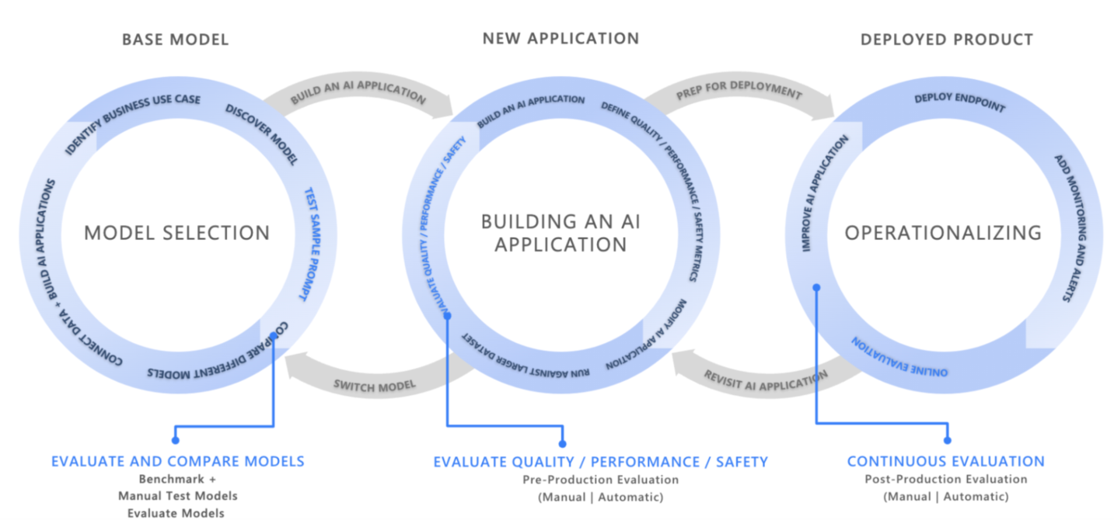
Building A LLMOps Framework
Source: GenAIOPS

Slide 10



Building A LLMOps Framework
Evaluations in AI Foundry
Evaluations Dimensions
Quality
Responsible AI
Groundedness
F1 Score
Self-harm-related
Code/Brand Vulnerability
LLM-as-a-Judge
Relevance
BLEU
Violent
Jailbreaks (UPIA)
AI Red Teaming (Agent)
Tool Call Accuracy
METEOR
Hateful
Jailbreaks (XPIA)
LLM
….
….
….
….
Proactive
AIClinic
(Custom)
MEDEC (Custom)
Sexual related
Undergrounded attributes
Evaluations Types
Semantic/Classification Metrics
Reactive
Evaluation Behavior
Source: Evaluations-Metrics, MEDEC, Red Team
Risk And Safety Metrics

Slide 11

Building A LLMOps Framework
HEAD-QA
Mapping Domains With Datasets
HeadQA Datasets
Medical Domain
Medical Subdomain
Define Tasks
Clinical Decision Support
Provide Clinical Knowledge Support
A multi-choice question answering testbed to encourage research on complex reasoning. The questions come from exams to access a specialized position in the Spanish healthcare system and are challenging even for highly specialized humans.
Support treatment Response
Suggest Clinical pathways
Need to evaluate the clinical knowledge of my foundation models – going to choose HEAD-QA
LLM/SLM Candidates Pool
microsoft-biogpt-large-pubmedqa
Also, we need to collect a private dataset with internal clinical pathways to test the model’s accuracy.
Gpt4o
Based on the tasks
these are my
candidates
Data Scientist/
AI Engineer
Source: MedHelm

